Slide 1





Used Car Price Prediction
Dnyaneshwari​ Gavhane
PGA-46
Capstone Project-I

Slide 2
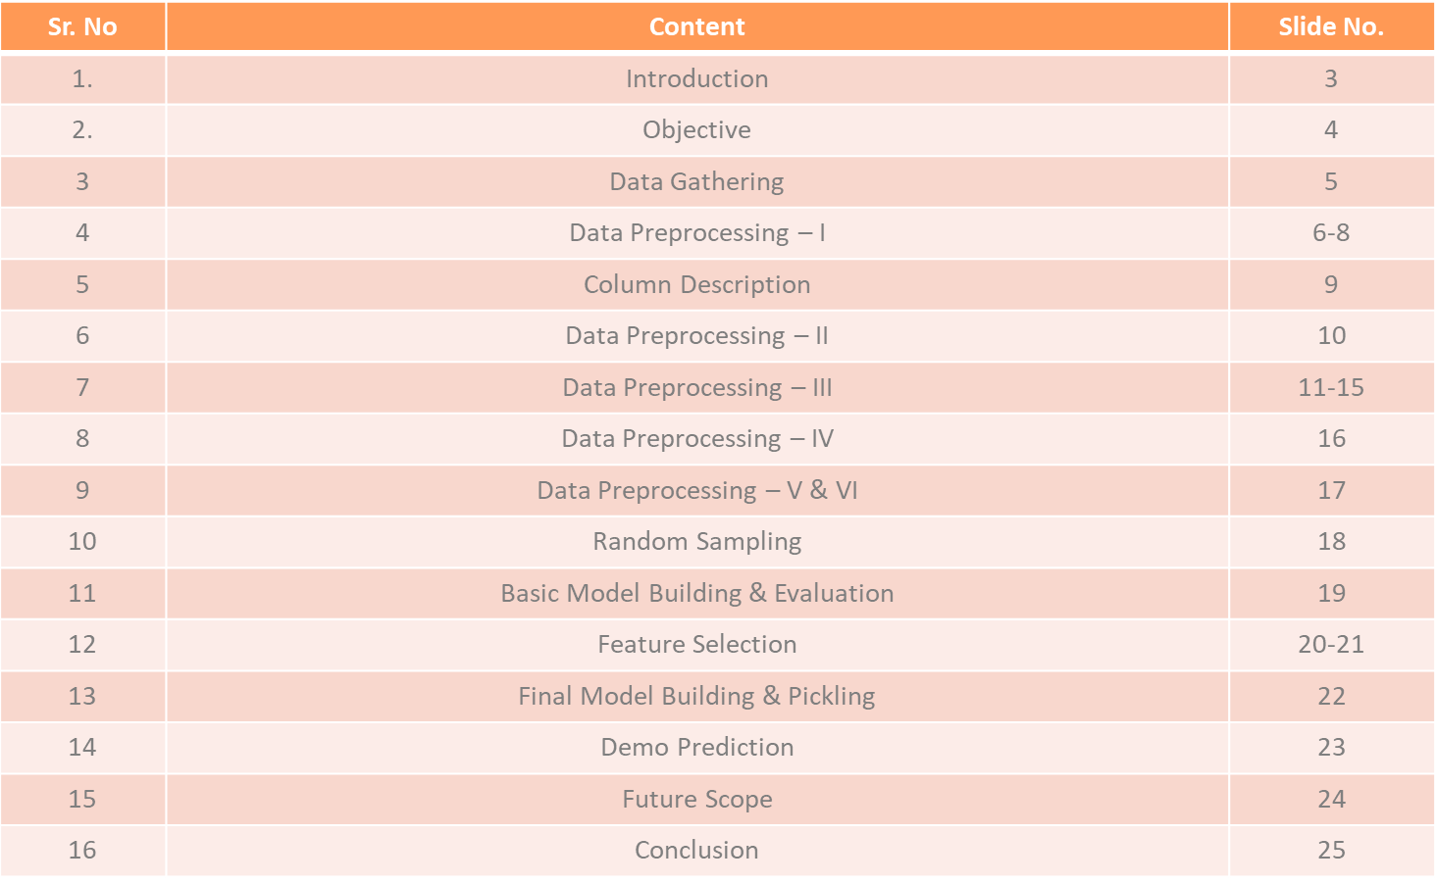
Table Of Content

Slide 3
Introduction
The automotive industry has undergone significant transformations in recent years, with a surge in the popularity of used cars.
As consumers seek reliable and cost-effective alternatives, the demand for accurate pricing models for used cars has become increasingly crucial.
In response to this, this project focuses on predicting the prices of used cars based on various features and attributes.

Slide 4

Objective
Goal is to leverage machine learning techniques to develop a robust and accurate price prediction model that assists both sellers and buyers in making informed decisions.

Slide 5
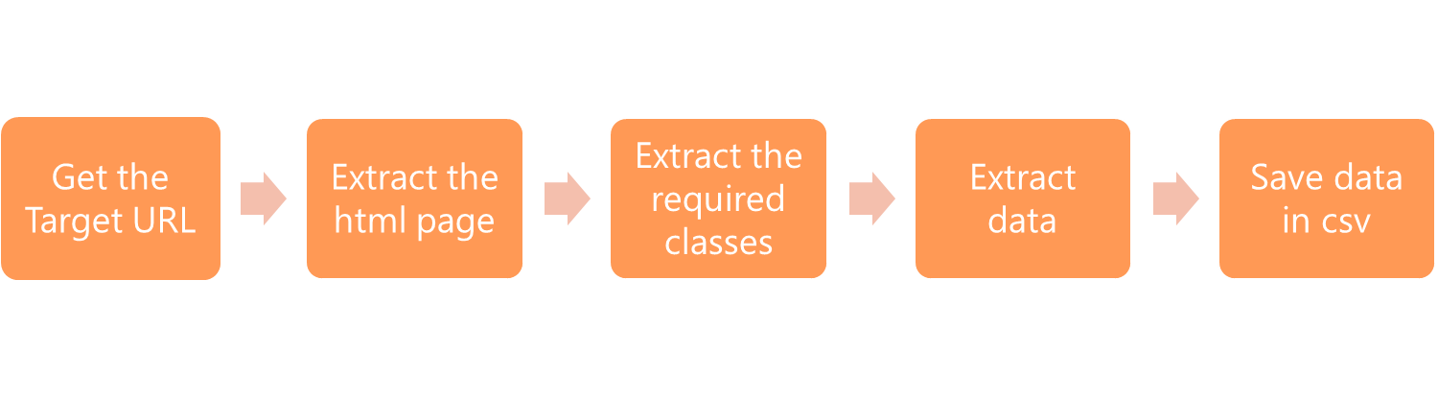
Data Gathering
For this project, data is sourced from the widely-used online platform, Cars24.
Employing Selenium, a web scraping tool, we navigated through the Cars24 website to extract essential information such as the make, model, year of manufacture, mileage, and other specifications for a diverse array of used cars.

Slide 6
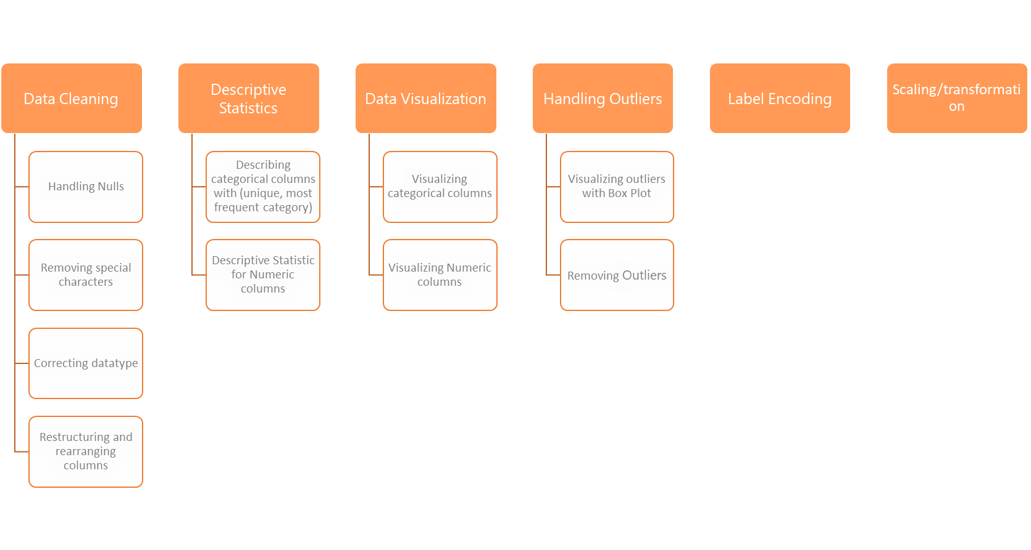
Data Preprocessing

Slide 7
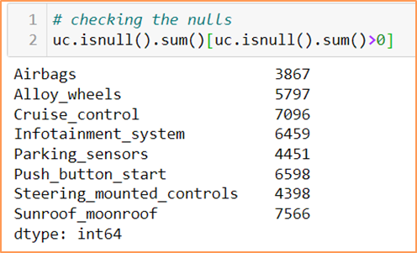
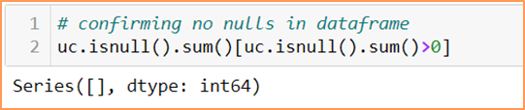
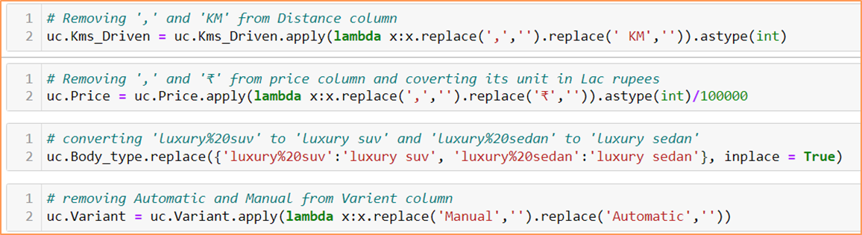
Data Preprocessing - I
Handling Nulls
Removing special characters & correcting datatypes

Slide 8
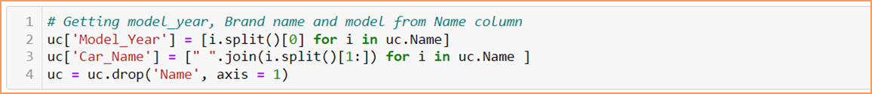
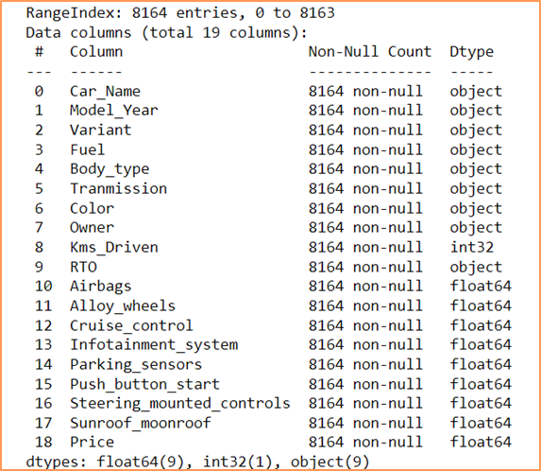
Data Preprocessing - I
Restructuring and rearranging columns
Data After Cleaning

Slide 9
Column Description
Car_Name : The Car_Name attribute includes both the car brand name and model name.
Model_Year: Model_Year represents the manufacturing year of the car.
Variant : Variant refers to the specific version or configuration of the car model.
Fuel: This attribute indicates the type of fuel the car uses, such as petrol, diesel, CNG
Body_type: Body_type describes the physical structure of the car, such as sedan, hatchback, SUV, etc.
Transmission: Transmission specifies the type of gearbox the car is equipped with, such as manual or automatic.
Color: Color represents the exterior color of the car.
Owner: Owner indicates the number of previous owners the car has had.
Kms_Driven: Kms_Driven represents the total distance the car has been driven, usually measured in kilometres.
RTO: RTO stands for Regional Transport Office, and this attribute may include information about the region where the car is registered.
Airbags: It represents whether the car has airbag or not ( 0 means No and 1 means Yes)
Alloy_wheels: This attribute indicates whether the car is equipped with alloy wheels ( 0 means No and 1 means Yes)
Cruise_control : Cruise_control denotes whether the car is equipped with a system that automatically maintains a set speed chosen by the driver. ( 0 means No and 1 means Yes)
Infotainment_system: Infotainment_system refers to the in-car entertainment and information system, which may include features like touchscreen displays, navigation, and connectivity options. ( 0 means No and 1 means Yes)
Parking_sensors: Parking_sensors are sensors installed in the car to assist in parking by providing proximity warnings. ( 0 means No and 1 means Yes)
Push_button_start: It represents whether the car has a keyless ignition system ( 0 means No and 1 means Yes)
Steering_mounted_controls: This attribute indicates whether the car's steering wheel has controls for functions such as audio, phone, or cruise control ( 0 means No and 1 means Yes)
Sunroof_moonroof: It represents whether the car is equipped with a sunroof or moonroof ( 0 means No and 1 means Yes)
Price: Price represents the cost of the car (in lacs), which can vary based on factors such as brand, model, features, and condition.

Slide 10
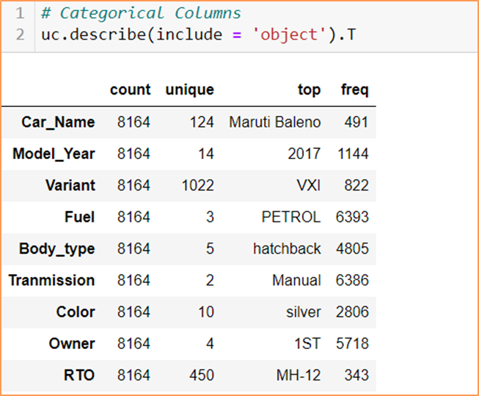
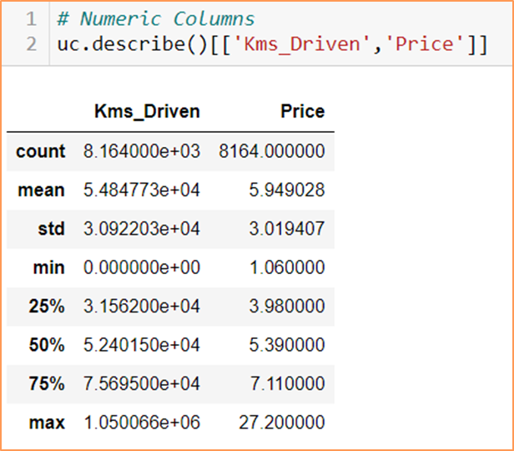
Data Preprocessing - II
Descriptive Statistics
Categorical columns
Numerical columns

Slide 11
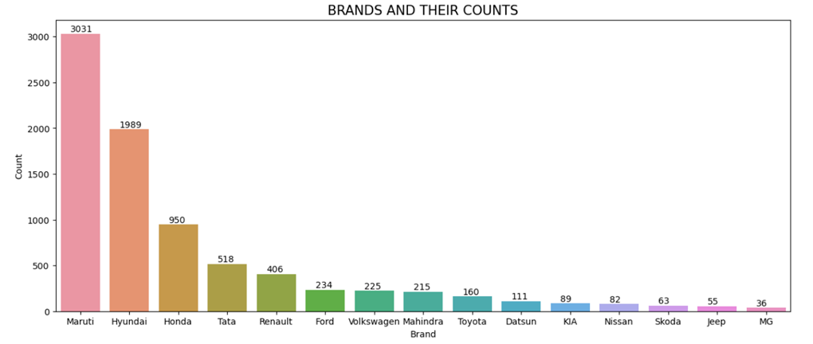
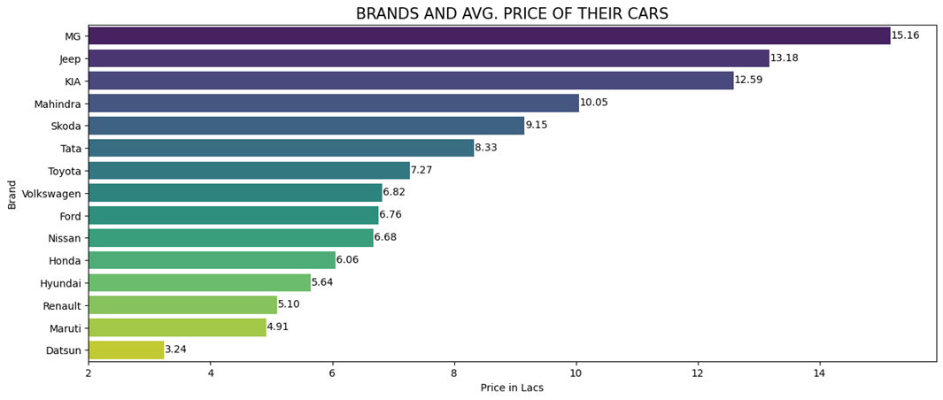
Data Preprocessing - III
Maruti dominates the market of used cars.
Maruti and Hyundai covers more than 50% of the market in used cars.
Maruti, Hyundai, Honda and Tata covers more than 80% of the used cars' market.
MG and Jeep have less number of cars as compared to others
Used Maruti and Datsun cars are more affordable.
MG, Jeep & KIA cars are more expensive

Slide 12
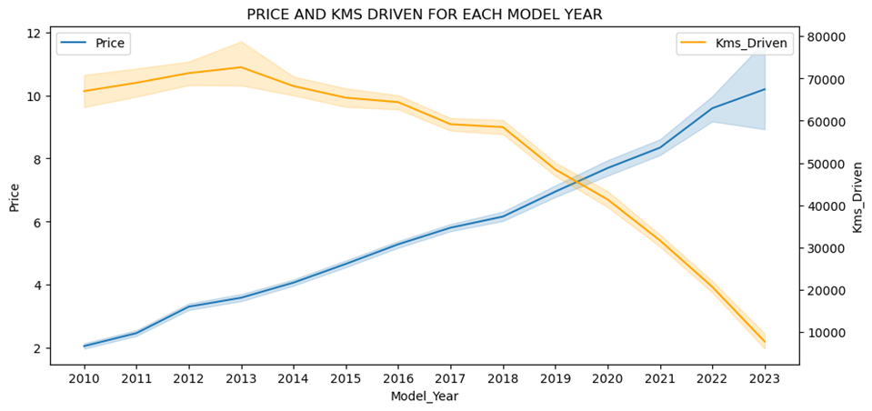
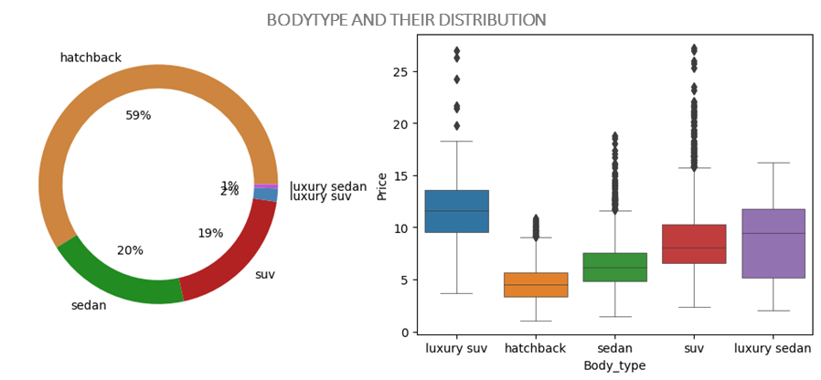
Data Preprocessing - III
Newer cars are more expensive and price variation is also large as compared to old cars
Older cars have more distance travelled as compared to newer cars
More than 50% cars are hatchback and they are very affordable
Luxury SUVs are most expensive cars

Slide 13
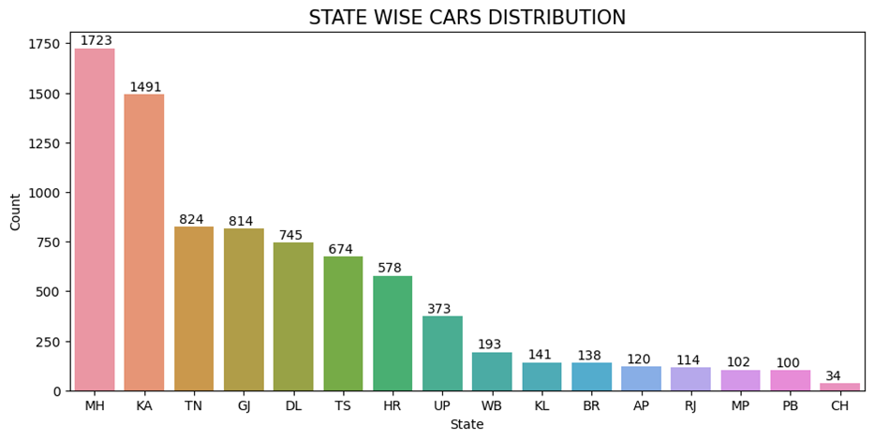
Data Preprocessing - III
Maharashtra and Karnataka has high number of cars.
In Kerala, Bihar, Andra Pradesh, Rajasthan, Madhya Pradesh, Panjab and Chandigarh has lowest number of used cars. More marketing at these state can implemented.

Slide 14
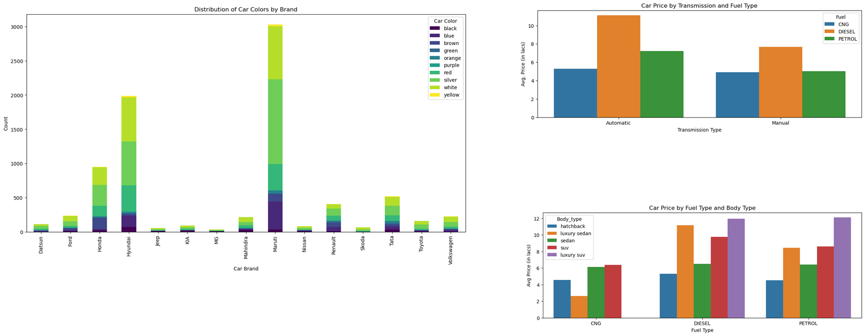
Data Preprocessing - III​
Automatic Transmission cars are more expensive in all fuel categories and in automatic transmission diesel car is most expensive
Avg. price for CNG fuel type car is same for both manual and automatic transmission gear type cars
In each brand most brought colours are red, silver and white
CNG cars are more affordable in all Body_type categories
Diesel and Petrol cars has almost equal price variation among Body_type categories.

Slide 15
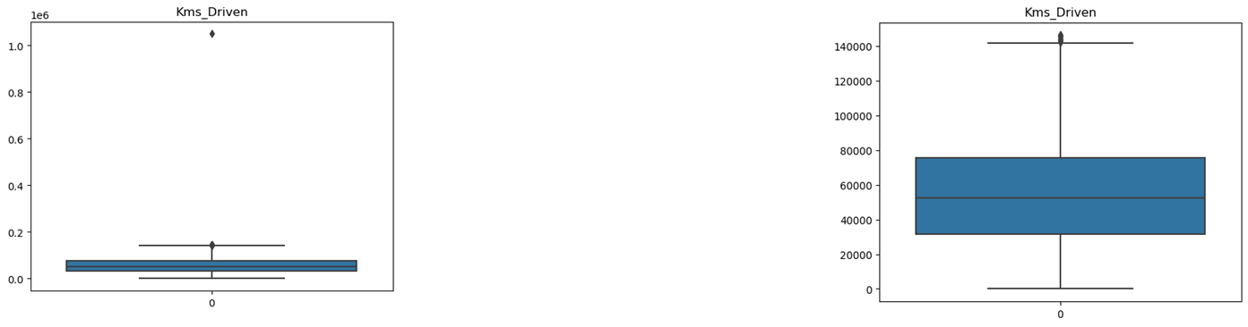
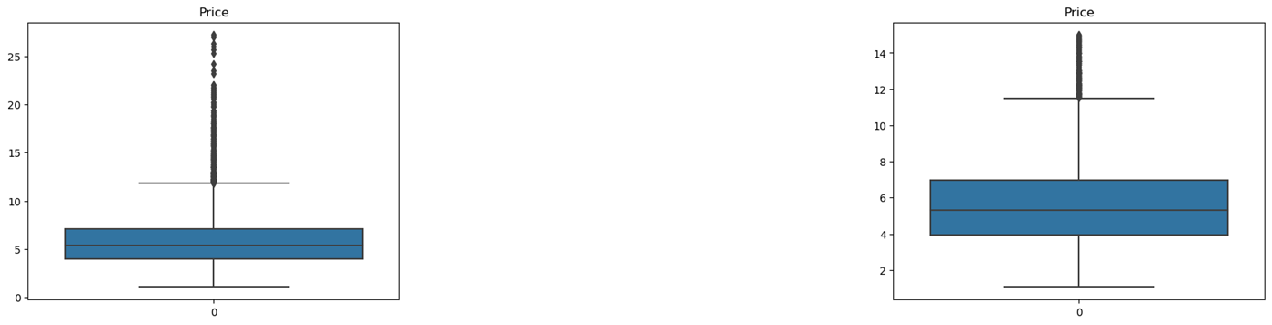
Data Preprocessing - IV
Outlier Removal from Kms_Driven:
Only one record had Kms_Driven more than 20e4
Removed this by selecting all records below 20e4 Kms_Driven
Outlier Removal from Price:
Removed extreme outliers below -3 σ & above +3 σ

Slide 16
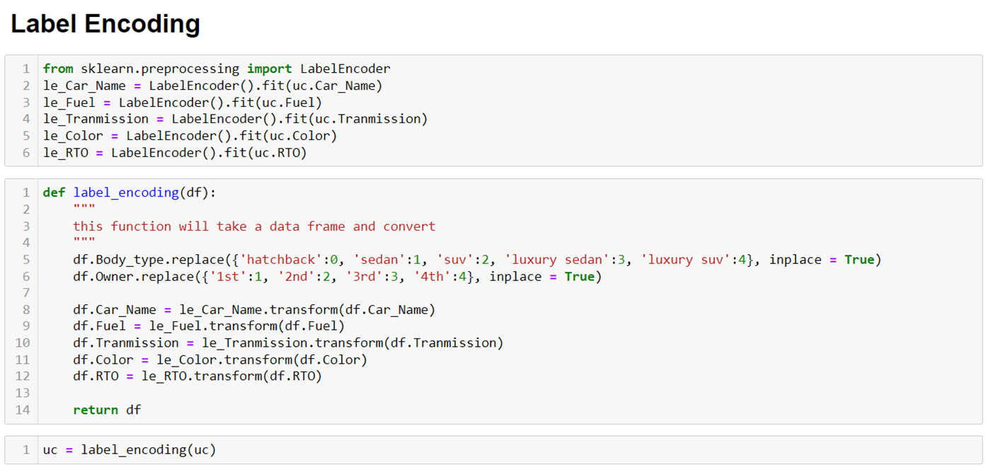
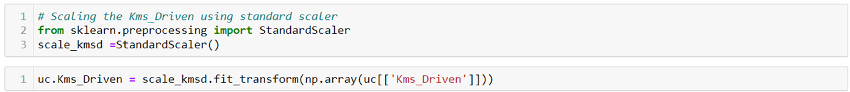
Data Preprocessing – V & VI​

Slide 17
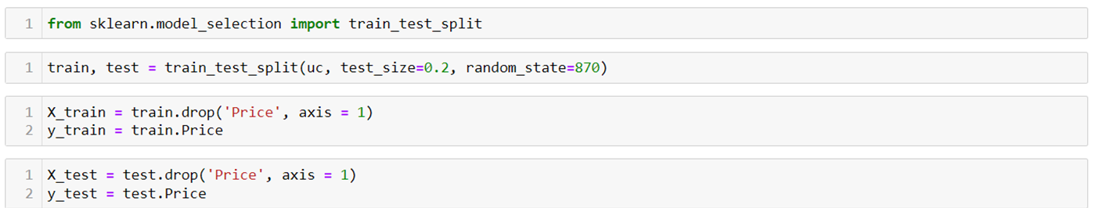
Random Sampling
Divide data into Train And Test :

Slide 18
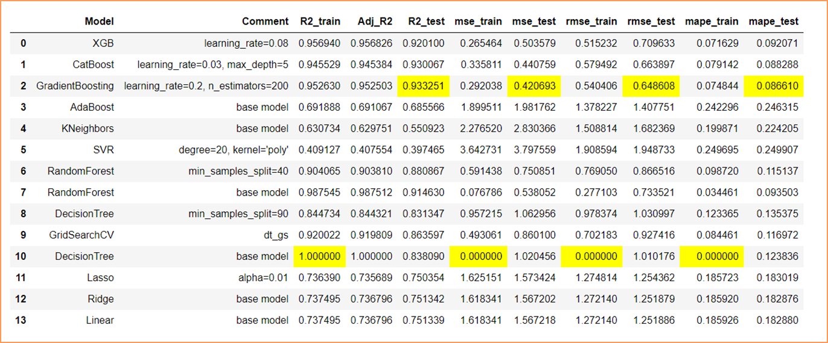
Basic Model Building & Evalution
CatBoost Regressor algorithm with learning_rate=0.03, max_depth=5 and GradientBoosting Regressor algorithm with learning_rate=0.2, n_estimators=200 are best performing models
CatBoost Regressor model has slightly lower R square but it is more robust than GradientBoosting Regressor model.

Slide 19
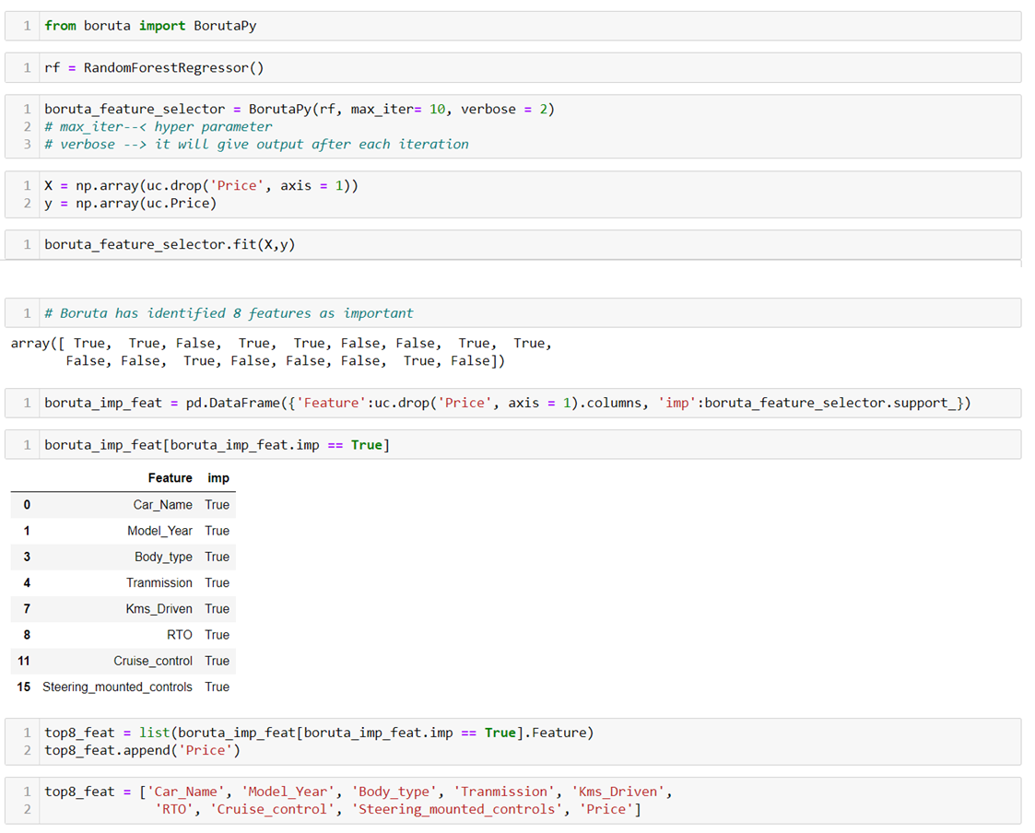
Feature Selection-I

Slide 20
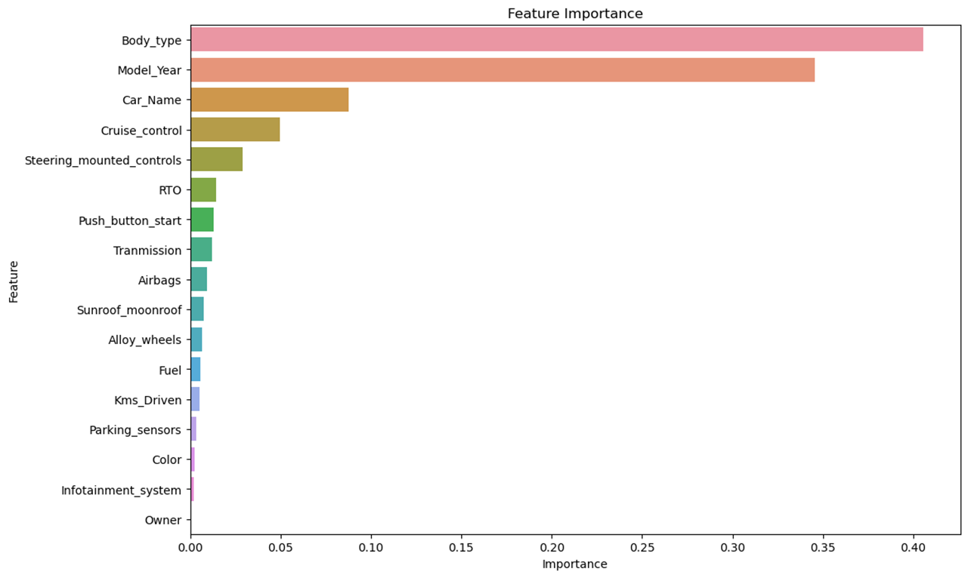
Feature Selection-II
Visualizing Feature Importance using Random Forest regressor algorithm

Slide 21
Final Model
After Feature selection GradientBoosting & CatBoost Regressor both are performing well.
CatBoost Regressor model has slightly lower R square but it is more robust than GradientBoosting Regressor model.

Slide 22
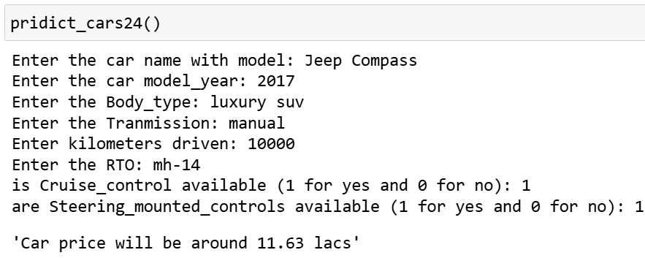
Demo Prediction

Slide 23
Feature Scope Prediction​
As we conclude this project on predicting used car prices, the following areas present promising avenues for future exploration and enhancement:
Enhanced Feature Engineering: Investigate the incorporation of additional features or external datasets that could further refine the predictive model. This might include factors such as service history, accident records, economic indicators, regional market trends, physical condition of car, etc
User-Friendly Applications: Develop user-friendly applications or tools that simplify the process of obtaining price predictions for both sellers and buyers. Consider incorporating visualization features to make the results more accessible and comprehensible.
Integration with Dealer Platforms: Collaborate with used car dealerships to integrate the pricing model into their platforms, providing real-time pricing guidance for sellers and buyers.
Incorporate Advanced ML Techniques: Explore advanced machine learning techniques like neural networks to further improve prediction accuracy and handle complex relationships in the data.

Slide 24
Conclusion
The project successfully addressed the growing need for accurate pricing models in the used car market. Leveraging machine learning techniques and web scraping tools, the model provides valuable insights into the factors influencing used car prices.
The visualization observations shed light on market trends and regional variations.
The outlier removal process enhanced the model's robustness, ensuring more reliable predictions.
The feature selection step identified key attributes affecting car prices, streamlining the model for better performance.
The comparison of CatBoost Regressor and GradientBoosting Regressor highlighted the trade-offs between R-square values and model robustness, with CatBoost demonstrating slightly lower R-square but greater resilience.

Slide 25
Thank You!

